Slide 1

HCI Coding Exercise
Renny Barrett
February 2025

Slide 2
TODO structure, animate

Slide 3
Demo
Notes:
README.md docs have lots of documentation on things like:
Functionality
Usability
Performance
Scalability
Concurrency
Security
Legislation
Robustness
Accessibility
Localisation

Slide 4
Entity Relationship Diagram
HospitalEntity
Name
Id
CreatedTime
UpdatedTime
0-1 Hospital
0-m PatientHospitals
PatientEntity
FirstName
LastName
Email
Id
CreatedTime
UpdatedTime
Patient-Hospital-Relation
PatientId
HospitalId
VisitId
0-1 Patient
0-m PatientHospitals
0-m PatientHospitals
VisitEntity
Date
Id
CreatedTime
UpdatedTime
?
0-1 Visit
Notes:
PatientHospitalRelation doesn’t extend Entity<Guid>
TODO animate
It makes no sense for a VisitEntity to relate to many PHRs.
PHR should be an entity, with a date attribute, and mandatory “1” relationshis to hospital and patient. Should be renamed to PatientHospitalVisit. It’s ok to have a hospital with no visit, or a patient with no visits.

Slide 5
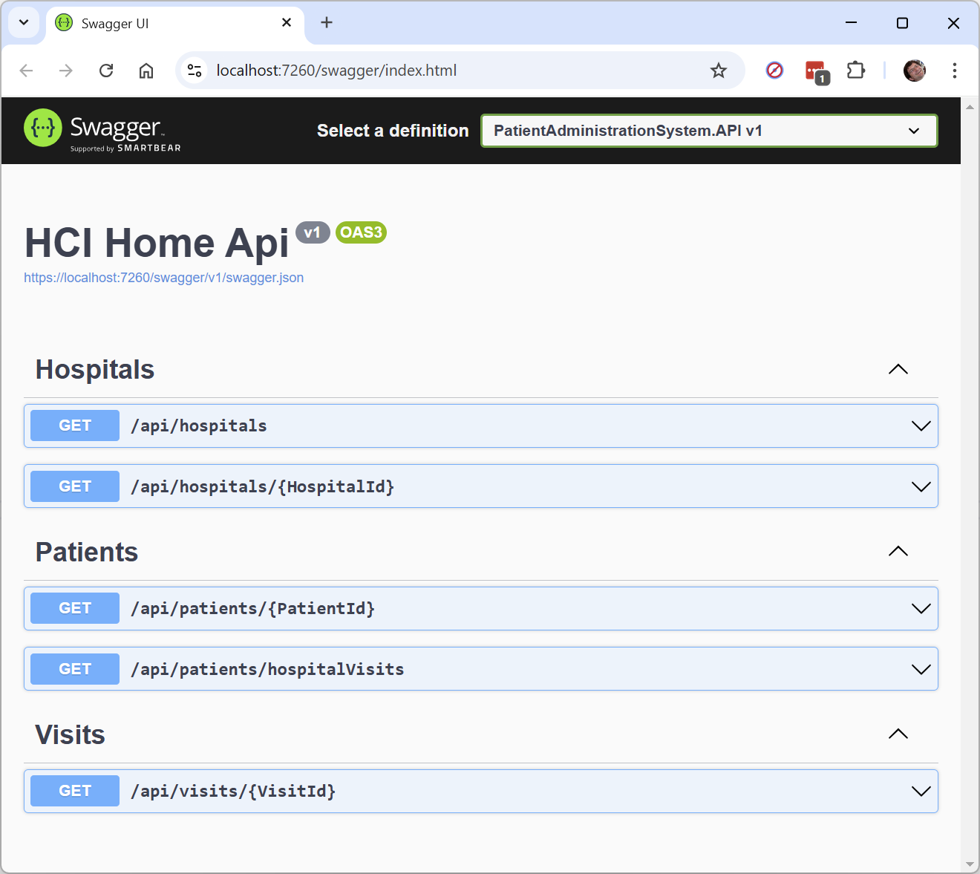
API definitions (Swagger)

Slide 6
Skills
The coding exercise | My experience
C# | Java
NUnit, Jest | JUnit
.NET core | Spring
LINQ, DbContext | Hibernate
Visual Studio | Eclipse
REACT | JSPs
TypeScript | JavaScript (Node.js)
Notes:
C#/Java includes both the languages and the surrounding tools and ecosystem, best practices, conventions…

Slide 7
One more week…
Lots to choose from in the README.md files!
Present list to customer, ask what their favourites would be
Guidance from product owner on priorities

Slide 8
Thank you!
Hope you’ve enjoyed this video
Looking forward to talking through in person!

